Slide 1



How to build end-to-end recognition system (Part 1): Best Practices.
Review from
deepsystems.ai
“apple”
Notes:
Hello everyone! I’m Max
Hello, I’m Denis!
This is the second part of our lecture about how to build end-to-end recognition system.

Slide 2
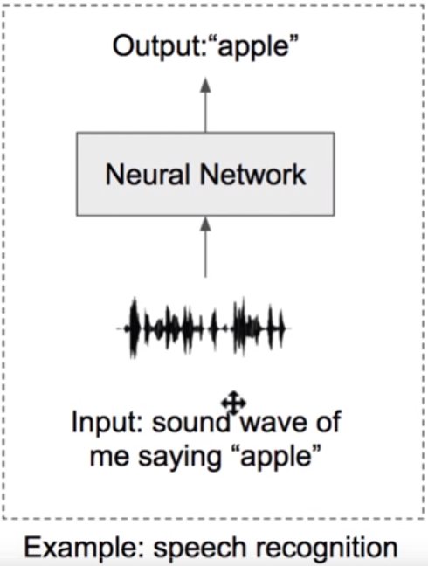
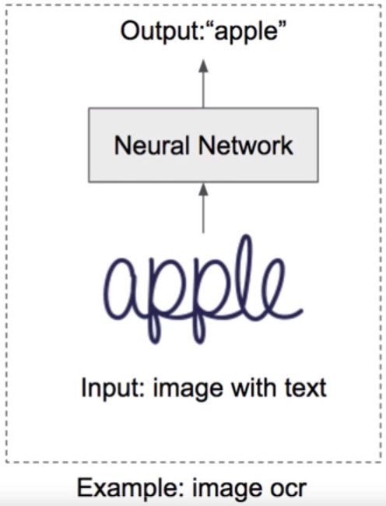
Task Description
Labelling unsegmented sequence data. i.e. training data is not pre-segmented.

Slide 3
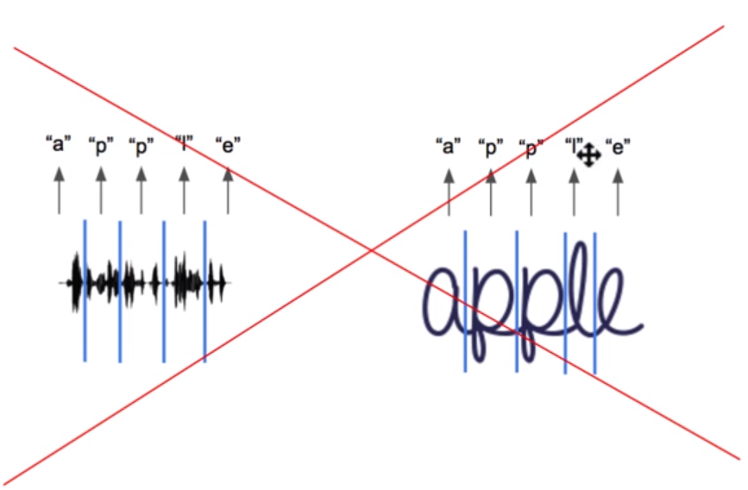
Task Description
Labelling unsegmented sequence data. i.e. training data is not pre-segmented.
We can not pre-segment input
data because:
It is too time consuming
It is too expensive
It is impossible in most cases

Slide 4
Image OCR: model architecture
High-level overview

Slide 5
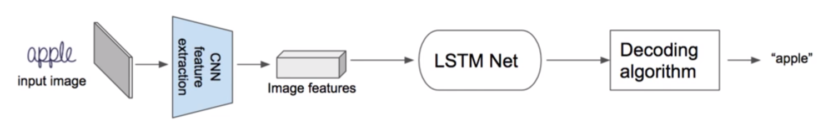

Slide 6
Image OCR: model architecture
Detailed overview

Slide 7
CNN feature extraction
4*8*4
Reshape
input image
lstm
This is the probability
distribution of observing
alphabet symbols at time1
(time1 - first Istm step)
16*1
In our simple example: Alphabet={"a", "e", "I", "p", "z", "-"}
|Alphabet| = 6
"-" is a special symbol (blank) that we always should add
to the alphabet. It will be further understood what it is used
for.
FC+SM
6*1

Slide 8
CNN feature extraction
4*8*4
Reshape
input image
lstm
This is the probability
distribution of observing
alphabet symbols at time1
(time1 - first Istm step)
16*1
In our simple example: Alphabet={"a", "e", "I", "p", "z", "-"}
|Alphabet| = 6
"-" is a special symbol (blank) that we always should add
to the alphabet. It will be further understood what it is used
for.
FC+SM
y_{a} -probability of observing "a" at time1
6*1

Slide 9
CNN feature extraction
4*8*4
Reshape
input image
lstm
This is the probability
distribution of observing
alphabet symbols at time1
(time1 - first Istm step)
16*1
In our simple example: Alphabet={"a", "e", "I", "p", "z", "-"}
|Alphabet| = 6
"-" is a special symbol (blank) that we always should add
to the alphabet. It will be further understood what it is used
for.
FC+SM
y_{e} -probability of observing "e" at time1
6*1

Slide 10
CNN feature extraction
4*8*4
Reshape
input image
lstm
This is the probability
distribution of observing
alphabet symbols at time1
(time1 - first Istm step)
16*1
In our simple example: Alphabet={"a", "e", "I", "p", "z", "-"}
|Alphabet| = 6
"-" is a special symbol (blank) that we always should add
to the alphabet. It will be further understood what it is used
for.
FC+SM
y_{z} -probability of observing "z" at time1
6*1

Slide 11
CNN feature extraction
4*8*4
Reshape
input image
lstm
This is the probability
distribution of observing
alphabet symbols at time1
(time1 - first Istm step)
16*1
In our simple example: Alphabet={"a", "e", "I", "p", "z", "-"}
|Alphabet| = 6
"-" is a special symbol (blank) that we always should add
to the alphabet. It will be further understood what it is used
for.
FC+SM
6*1
y_-probability of observing "-" (blank) at time1

Slide 12
64*128*3
16*8
CNN feature extraction
4*8*4
Reshape
input image
lstm
lstm
lstm
lstm
lstm
lstm
lstm
lstm
16*1
16*1
16*1
16*1
16*1
16*1
16*1
16*1
FC+SM
FC+SM
FC+SM
FC+SM
FC+SM
FC+SM
FC+SM
FC+SM
6*1
6*1
6*1
6*1
6*1
6*1
6*1
6*1
We have 8 network outputs at different
times that are conditionally independent
Note: We designed simplified neural network to have 8 outputs. It means that we can
not recognize more than 8 characters per image
In practice, number of outputs can reach 32, 64 or more. The choice will depend on the specific task.

Slide 13
64*128*3
16*8
CNN feature extraction
4*8*4
Reshape
input image
lstm
lstm
lstm
lstm
lstm
lstm
lstm
lstm
16*1
16*1
16*1
16*1
16*1
16*1
16*1
16*1
FC+SM
FC+SM
FC+SM
FC+SM
FC+SM
FC+SM
FC+SM
FC+SM
6*1
6*1
6*1
6*1
6*1
6*1
6*1
6*1
How does decoding
algorithm work?
Decoding algorithm
"apple"

Slide 14
6*1
6*1
6*1
6*1
6*1
6*1
6*1
6*1
Find most
probable symbol
Find most
probable symbol
Find most
probable symbol
Find most
probable symbol
Find most
probable symbol
Find most
probable symbol
Find most
probable symbol
Find most
probable symbol
"ap-pl-ee"
Remove repeated symbols
Let's define this block of
operations as map function B,
that simply removes repeated
symbols from path and
removes "blanks"
"ap-pl-e"
Remove "blanks"
"Best path decoding" algorithm is defined by
this sequence of operations (most popular,
very simple and easy to implement).
"apple"
Note: there are a few other algorithms in
literature.

Slide 15
Thank you
Our Website:
deepsystems.ai
Products:
supervise.ly
Dataset management, annotation and preparation service
Interactive, lstm-based movie recommender system
movix.ai
Outsource projects:
Our team is looking for business partners to make exciting deep learning solutions.

